Slide 1
Neural Networks 2022-2023
LAB 3

Slide 2
Agenda
Single Layer Perceptron
Decision Boundary
Bias
Task 1 Description

Slide 3
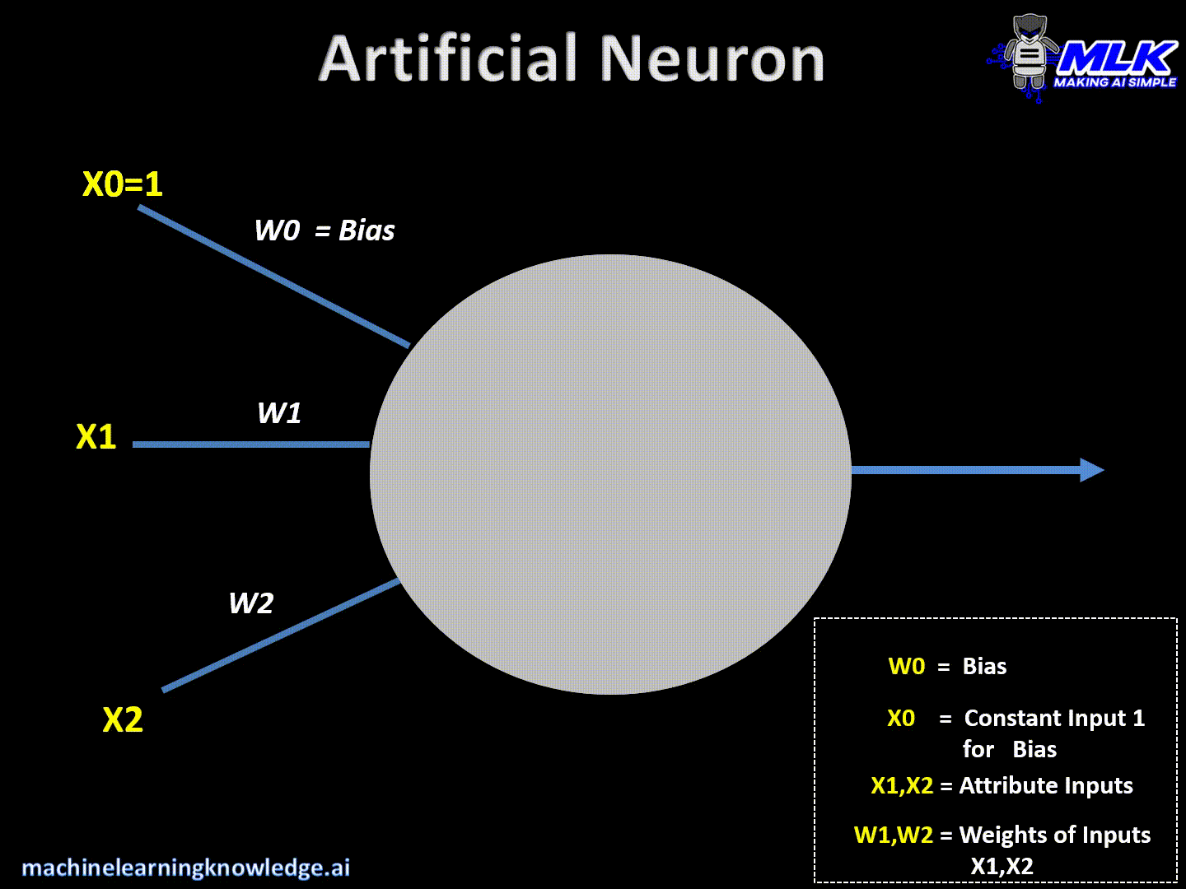
Neural Networks
Notes:
Input Layer :- This layer accepts input features. It provides information from the outside world to the network, no computation is performed at this layer, nodes here just pass on the information(features) to the hidden layer. Hidden Layer :- Nodes of this layer are not exposed to the outer world, they are the part of the abstraction provided by any neural network. Hidden layer performs all sort of computation on the features entered through the input layer and transfer the result to the output layer. Output Layer :- This layer bring up the information learned by the network to the outer world.

Slide 4
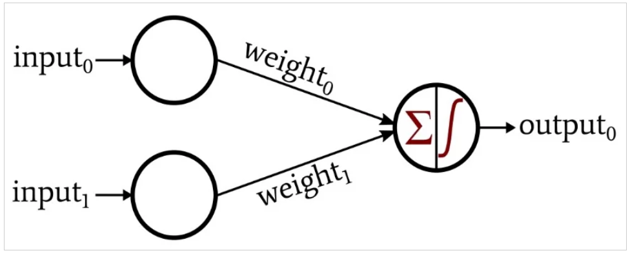
Single layer Perceptron
Any neural network consists of interconnected nodes arranged in layers. The nodes in the input layer distribute data, and the nodes in other layers perform summation and then apply an activation function.
The connections between these nodes are weighted, meaning that each connection multiplies the transferred datum by a scalar value.
Notes:
The network in the following figure, is a single layer network because it has only one layer that does computations (The input layer does not count)

Slide 5
Single layer Perceptron
Start with a randomly chosen weight vector w(0)
Repeat
For each training vector pair (𝑥_𝑖, 𝑡_𝑖)
evaluate the output 𝑦_𝑖 when 𝑥_𝑖 is the input according to 𝑦_𝑖 = signum 〖[𝑤(𝑖)〗^𝑇. 𝑥(𝑖)+𝑏]
if 𝑦_𝑖 ≠ 𝑡_𝑖 then
calculate loss L = (𝑡_𝑖 - 𝑦_𝑖)
form a new weight vector wi+1 according to
𝑤_(𝑖+1) = 𝑤_𝑖 + η.(𝑡_𝑖 - 𝑦_𝑖).𝑥_𝑖
else
do nothing
end if
End for
Until the stopping criterion (convergence) is reached

Slide 6
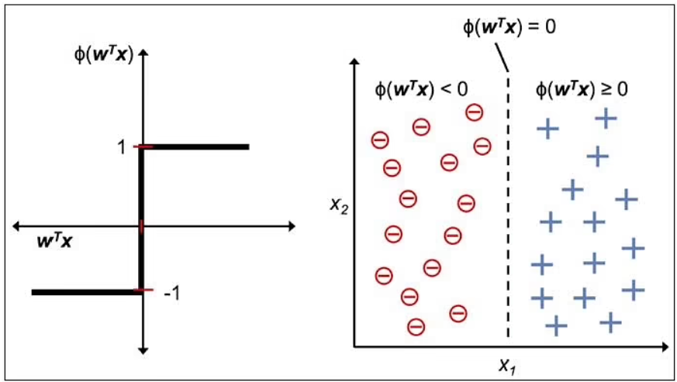
Single layer Perceptron – Decision Boundary
A decision boundary is a hyperplane that separates the data points into specific classes, where the algorithm switches from one class to another. On one side a decision boundary, a datapoints is more likely to be called as class A — on the other side of the boundary, it’s more likely to be called as class B.

Slide 7
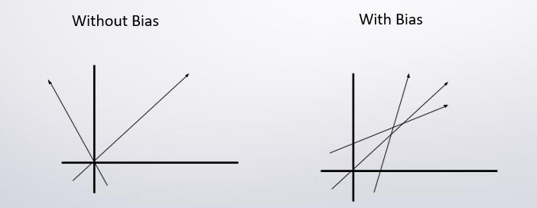
Single layer Perceptron – Bias
Bias is simply a constant value (or a constant vector) that is added to the product of inputs and weights. Bias is utilized to offset the result.
The bias is used to shift the result of activation function towards the positive or negative side.
Notes:
Due to absence of bias, model will train over point passing through origin only, which is not in accordance with real-world scenario. Also with the introduction of bias, the model will become more flexible.

Slide 8
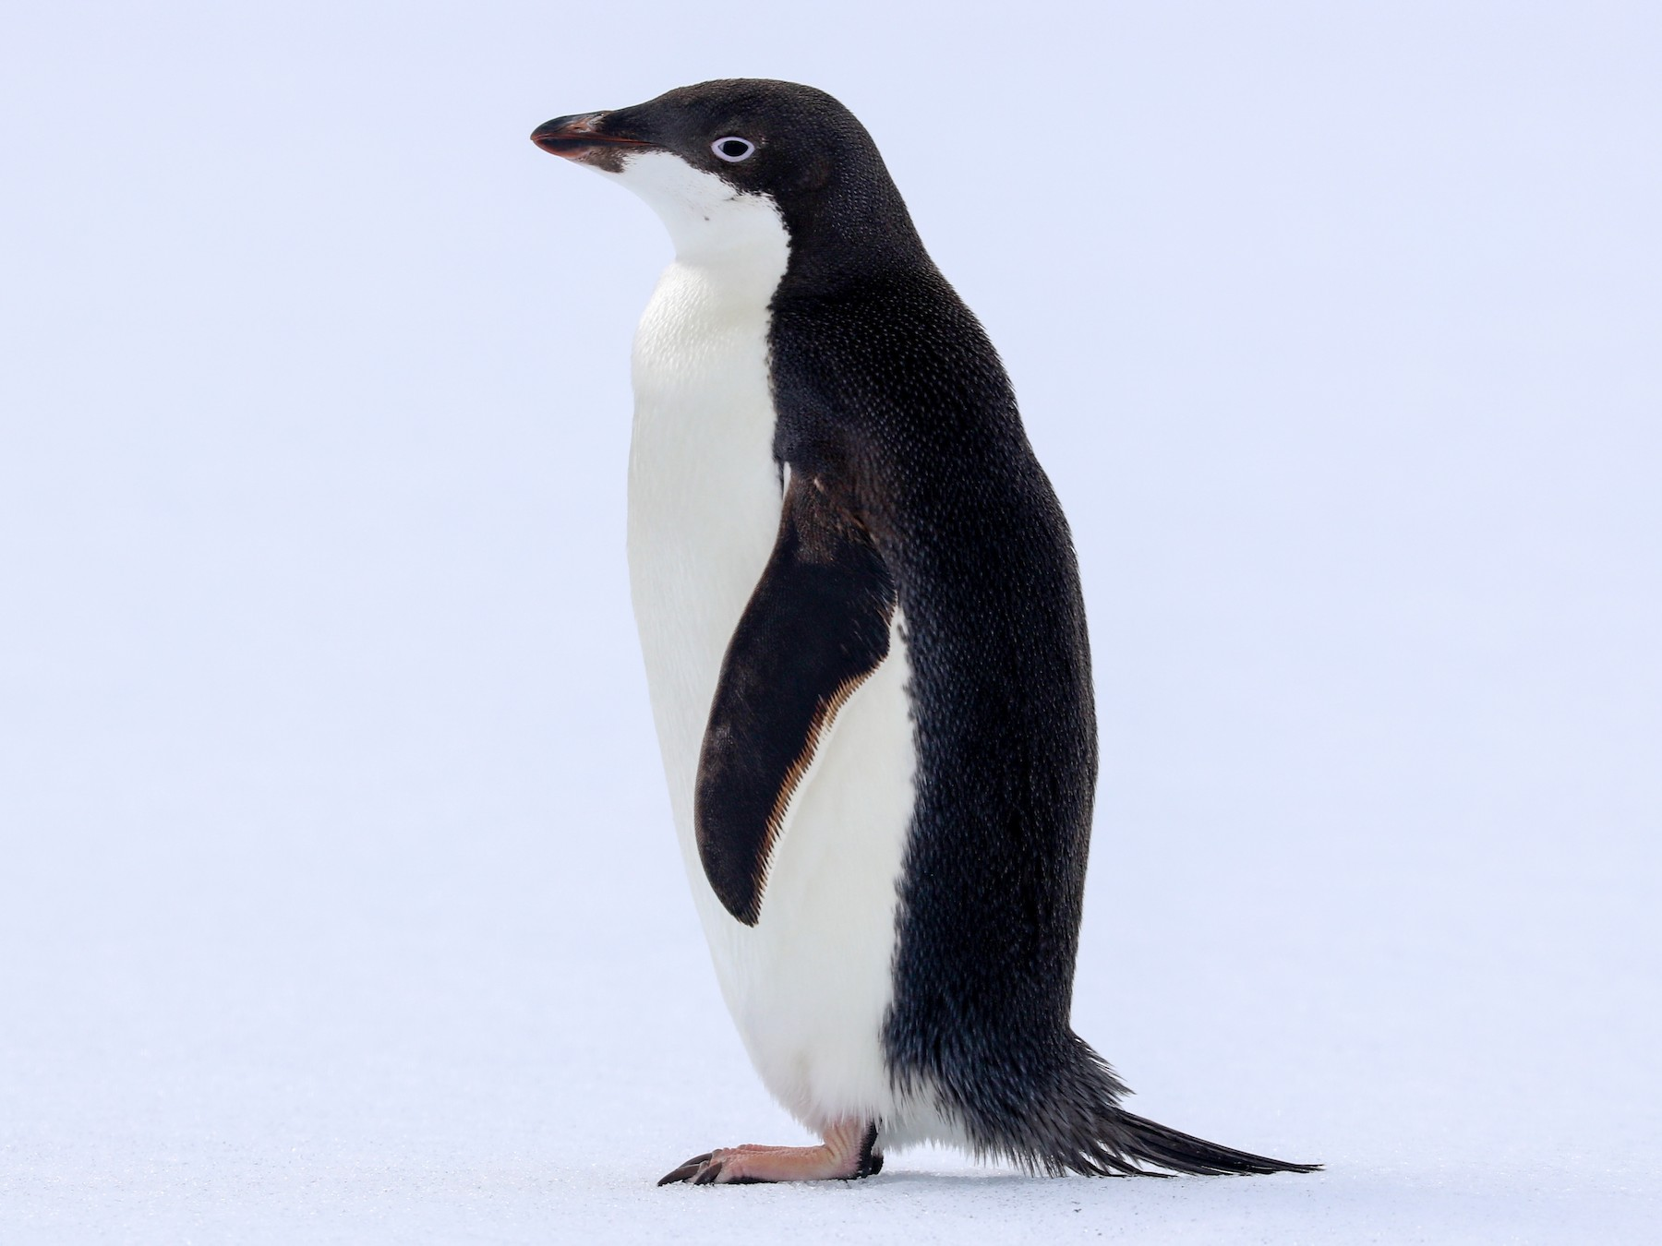
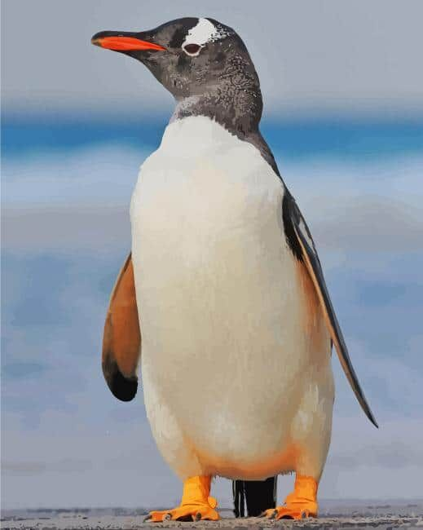
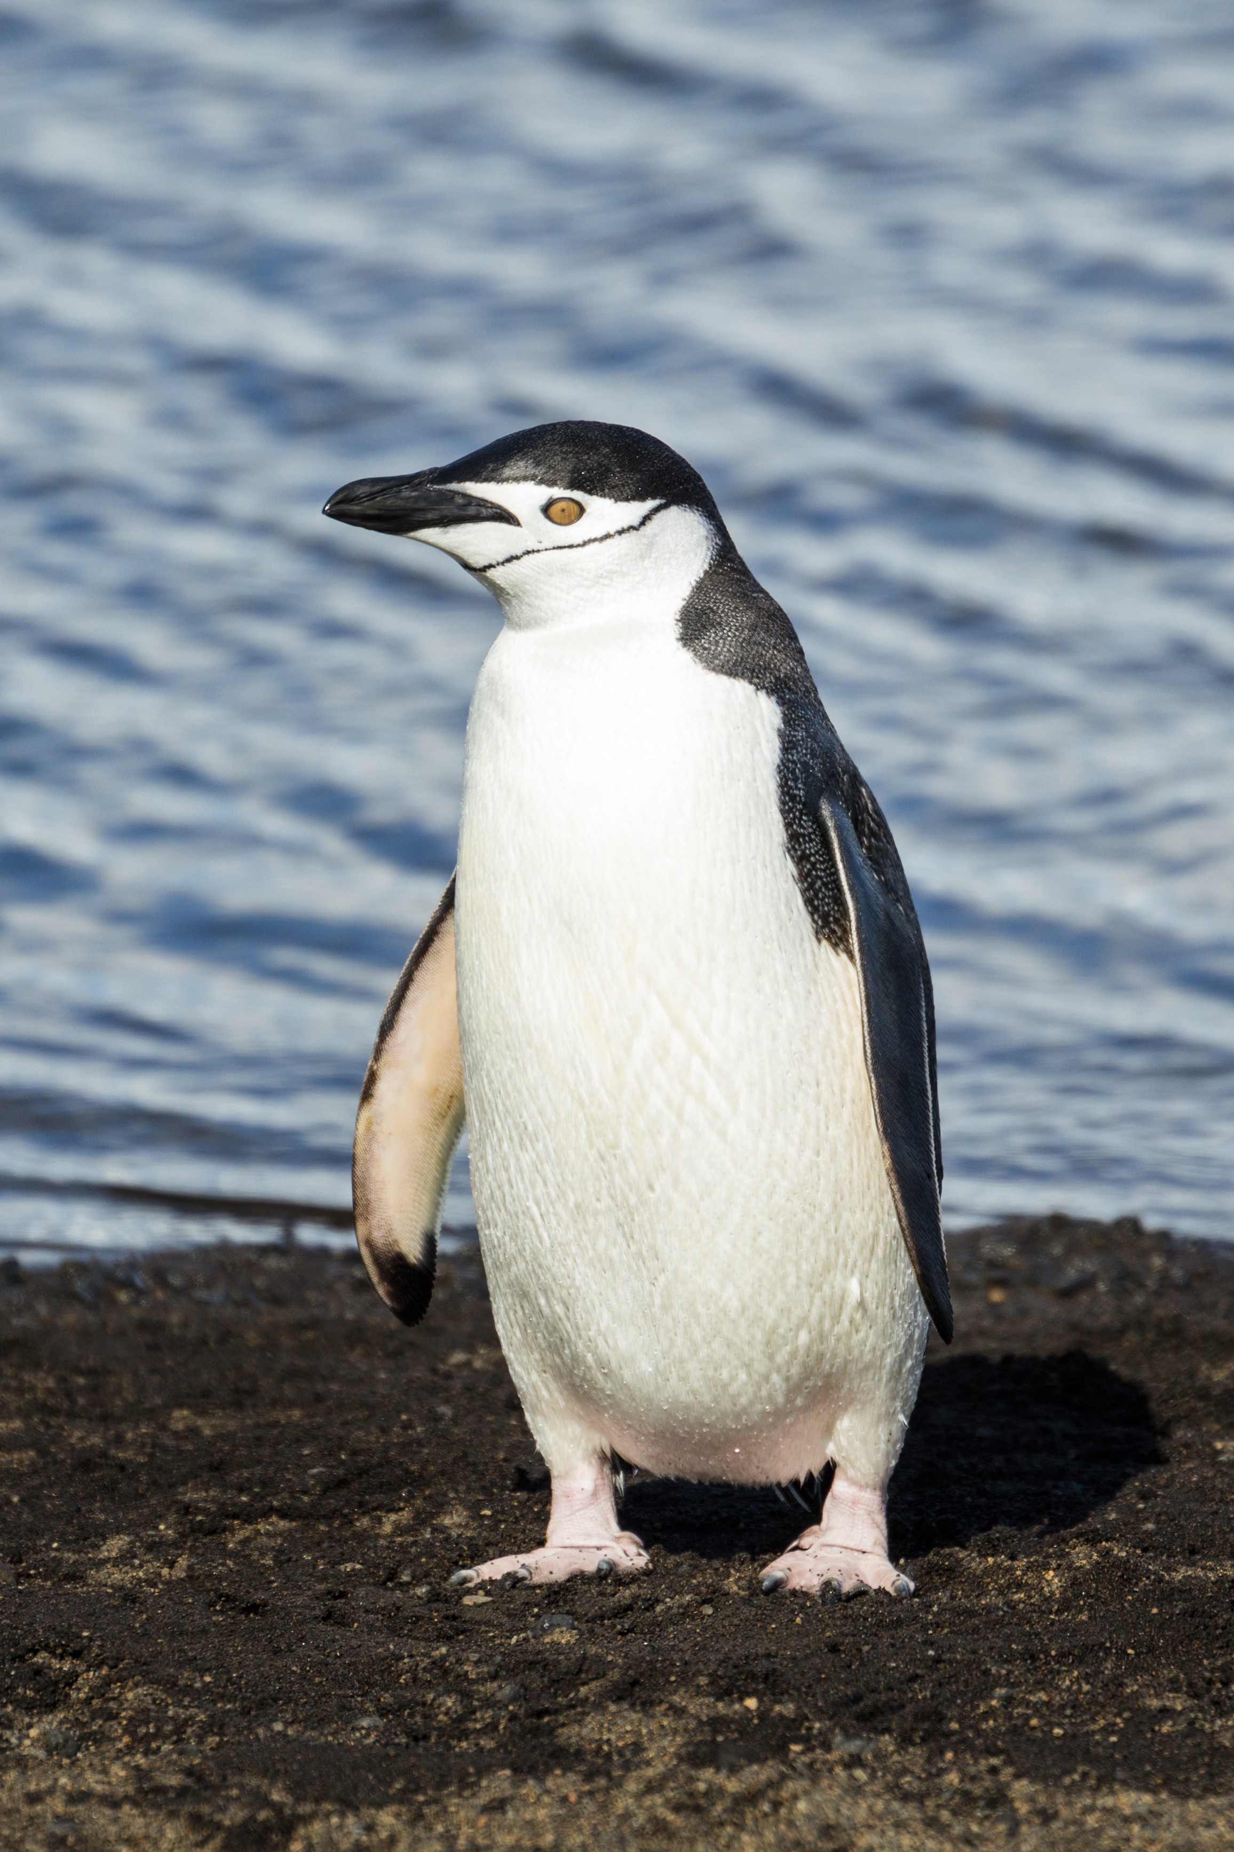
Task 1 – Dataset (Penguins)
The data set consists of 50 samples from each of three species of Penguins (Adelie, Gentoo and Chinstrap).
Five features were measured from each sample: bill_length, bill_depth, flipper_length, gender and body_mass, (in millimeter).
Adelie
Gentoo
Chinstrap

Slide 9
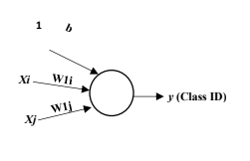
Task 1 - GUI
User Input:
Select two features
Select two classes (C1 & C2 or C1 & C3 or C2 & C3)
Enter learning rate (eta)
Enter number of epochs (m)
Add bias or not (Checkbox)
Initialization:
Number of features = 2.
Number of classes = 2.
Weights + Bias = small random numbers
Classification:
Sample (single sample to be classified).

Slide 10
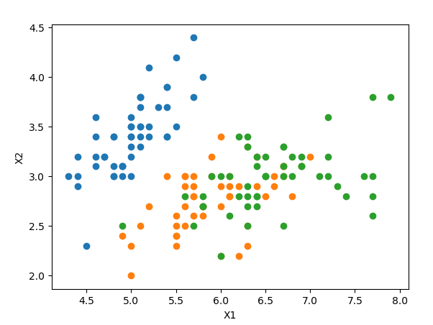
Task 1 - Description
Visualize Penguins dataset
Penguins' dataset contains 150 samples (50 samples/class). Each sample consists of 5 features.
The first part of task(1) is analyzing the data and making a simple report to know the linear/non-linear separable features. HINT: Drawing all possible combinations of features like (X1, X2), (X1, X3), (X1, X4), (X2, X3), (X2, X4), etc as shown in the following figure and determine which features are discriminative between which classes

Slide 11
Task 1 - Description
Implement the Perceptron learning algorithm
Single layer neural networks which can be able to classify a stream of input data to one of a set of predefined classes.
Use the penguins data in both your training and testing processes. (Each class has 50 samples: train NN with 30 non-repeated samples randomly selected, and test it with the remaining 20 samples)

Slide 12
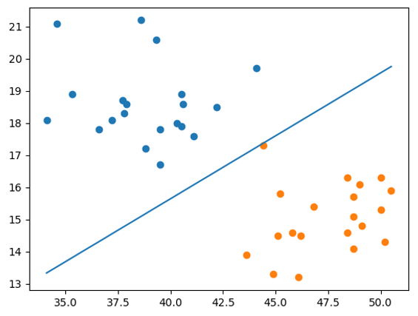
Task 1 - Description
After training
Draw a line that can discriminate between the two learned classes. You should also scatter the points of both classes to visualize the behavior of the line.
Test the classifier with the remaining 20 samples of each selected classes and find confusion matrix and compute overall accuracy.

Slide 13
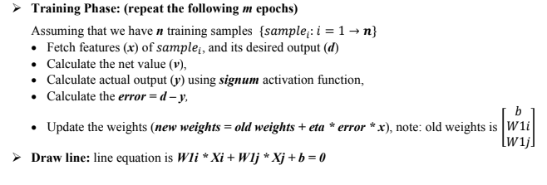
Task 1 - Workflow

Slide 14
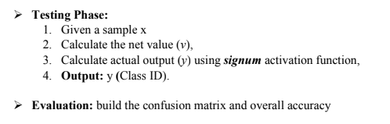
Task 1 - Workflow

Slide 15
Task 1 - Notes
You will be asked to deliver a .rar folder containing all your code files (.py), dataset and the visualization and analysis report.
In the report you should have screenshots/plots of the visualizations and a written analysis of what you understood from each of these visualizations and how the features discriminate or not between classes. You should have a plot and analysis for each combination (10 combinations)
At the end of the report, you should mention which features achieved the highest accuracy after running your algorithm.
You should not drop any row from the dataset.
Using scikit-learn metrics library or any similar built-in function for the confusion matrix is not allowed.

Slide 16
Task 1 - Notes
Lab 3 including Task 1 description will be available Thursday 27/10/2022. Task Deadline: 6/11/2022 11:59 PM
Please try to write well designed code.
Separate the logic (generation, loading, and classification) from the UI.
Writing well-documented, readable, maintainable, and extensible code is an extremely important skill you must master before graduating. So, don’t be lazy!
Cheating will not be tolerated.

Slide 17
Thank you

